Slide 1
GAME ANALYSIS USING SQL

Slide 2
Decode Gaming Behavior
Dataset Description
Player Details Table:
`P_ID`: Player ID
`PName`: Player Name
`L1_status`: Level 1 Status
`L2_status`: Level 2 Status
`L1_code`:
System generated Level 1 Code
`L2_code`:
System generated Level 2 Code
Level Details Table:
`P_ID`: Player ID
`Dev_ID`: Device ID
`start_time`: Start Time
`stages_crossed`: Stages Crossed
`level`: Game Level
`difficulty`: Difficulty Level
`kill_count`: Kill Count
`headshots_count`: Headshots Count
`score`: Player Score
`lives_earned`: Extra Lives Earned

Slide 3
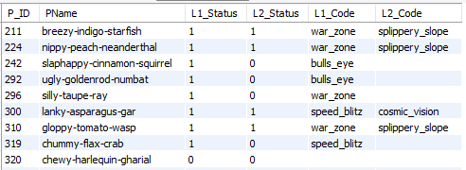
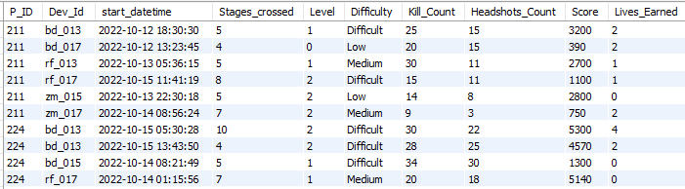
Player Details Table
Level Details Table

Slide 4
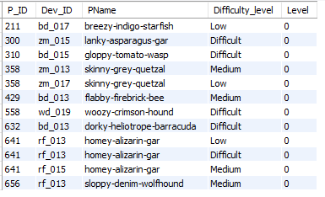
1. Extract `P_ID`, `Dev_ID`, `PName`, and `Difficulty_level` of all players at Level 0.
SELECT p.P_ID, ld.Dev_ID, p.PName, ld.Difficulty AS Difficulty_level,Level
FROM player_details p
JOIN level_details2 ld
ON p.P_ID = ld.P_ID
WHERE ld.Level = 0;

Slide 5
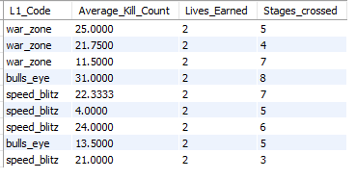
2. Find `Level1_code`wise average `Kill_Count` where `lives_earned` is 2, and at least 3 stages are crossed.
SELECT pd.L1_Code, AVG(ld.Kill_Count) AS Average_Kill_Count, ld.Lives_Earned, ld.Stages_crossed
FROM player_details pdJOIN level_details2 ld
ON pd.P_ID = ld.P_ID
WHERE ld.Lives_Earned = 2 AND ld.Stages_crossed >= 3
GROUP BY pd.L1_Code, ld.Lives_Earned, ld.Stages_crossed;

Slide 6
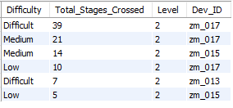
3. Find the total number of stages crossed at each difficulty level for Level 2 with players using `zm_series` devices. Arrange the result in decreasing order of the total number of stages crossed.
SELECT ld.Difficulty, SUM(ld.Stages_crossed) AS Total_Stages_Crossed, Level, ld.Dev_ID
FROM level_details2 ld
JOIN player_details pd
ON ld.P_ID = pd.P_ID
WHERE ld.Level = 2 AND ld.Dev_ID LIKE 'zm_%‘
GROUP BY ld.Difficulty, ld.Dev_ID
ORDER BY Total_Stages_Crossed DESC;

Slide 7
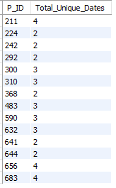
4. Extract `P_ID` and the total number of unique dates for those players who have played games on multiple days.
SELECT P_ID, COUNT(DISTINCT DATE_FORMAT(start_datetime, %y-%m-%d'))
AS Total_Unique_Dates
FROM level_details2
GROUP BY P_ID
HAVING COUNT(DISTINCT DATE_FORMAT(start_datetime, '%y-%m-%d')) > 1;

Slide 8
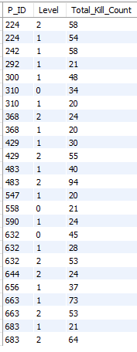
5. Find `P_ID` and levelwise sum of `kill_counts` where `kill_count` is greater than the average kill count for Medium difficulty.
SELECT P_ID, Level,
SUM(Kill_Count) AS Total_Kill_Count
FROM level_details2
WHERE Kill_Count > (
SELECT AVG(Kill_Count)
FROM level_details2
WHERE Difficulty = 'Medium‘
)
GROUP BY P_ID, Level;

Slide 9
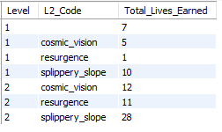
6. Find `Level` and its corresponding `Level_code`wise sum of lives earned, excluding Level 0. Arrange in ascending order of level.
SELECT ld.Level, pd.L2_Code, SUM(ld.Lives_Earned) AS Total_Lives_Earned
FROM level_details2 ld
JOIN player_details pd
ON ld.P_ID = pd.P_ID
WHERE ld.Level > 0
GROUP BY ld.Level, pd.L2_Code
ORDER BY ld.Level ASC;

Slide 10
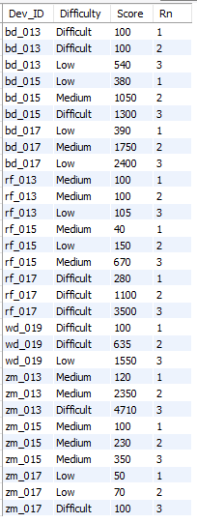
7. Find the top 3 scores based on each `Dev_ID` and rank them in increasing order using `Row_Number`. Display the difficulty as well.
SELECT subquery.Dev_ID, subquery.Difficulty, subquery.Score, subquery.Rn
FROM (
SELECT ld.Dev_ID, ld.Difficulty, ld.Score, ROW_NUMBER( )
OVER(PARTITION BY ld.Dev_ID ORDER BY ld.Score) AS Rn FROM level_details2 ld ) AS subquery
WHERE Rn <= 3;

Slide 11
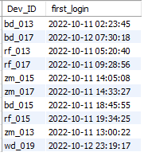
8. Find the `first_login` datetime for each device ID.
SELECT Dev_ID, MIN(start_datetime) AS first_login
FROM level_details2
GROUP BY Dev_ID;

Slide 12
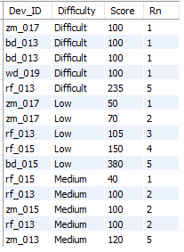
9. Find the top 5 scores based on each difficulty level and rank them in increasing order using `Rank`. Display `Dev_ID` as well.
SELECT subquery.Dev_ID, subquery.Difficulty, subquery.Score, subquery.Rn
FROM (
SELECT ld.Dev_ID, ld.Difficulty, ld.Score,
RANK( ) OVER (PARTITION BY ld.Difficulty ORDER BY ld.Score ASC) AS Rn
FROM level_details2 ld) AS subquery
WHERE Rn <= 5;

Slide 13
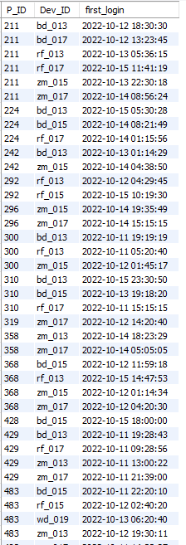
10. Find the device ID that is first logged in (based on `start_datetime`) for each player (`P_ID`). Output should contain player ID, device ID, and first login datetime.
SELECT P_ID, Dev_ID, MIN(start_datetime) AS first_login
FROM level_details2
GROUP BY P_ID, Dev_ID;

Slide 14
11. For each player and date, determine how many `kill_counts` were played by the player so far.
a) Using window functions
SELECT P_ID, DATE_FORMAT(start_datetime, '%y-%m-%d’) AS Date, Kill_Count, SUM(Kill_Count) OVER (PARTITION BY P_ID, DATE_FORMAT(start_datetime, '%y-%m-%d') ORDER BY start_datetime) AS Total_Played_Kills_So_Far
FROM level_details2
ORDER BY P_ID, start_datetime;
b) Without window functions
SELECT P_ID, DATE_FORMAT(start_datetime, '%y-%m-%d’) AS Date, Kill_Count, SUM(Kill_Count) AS Total_Played_Kills_So_Far
FROM level_details2
GROUP BY P_ID, start_datetime, Kill_Count
ORDER BY P_ID, start_datetime;

Slide 15
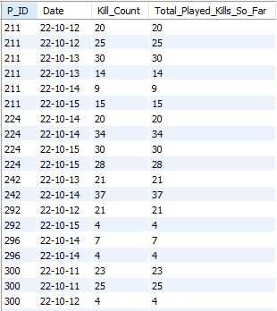
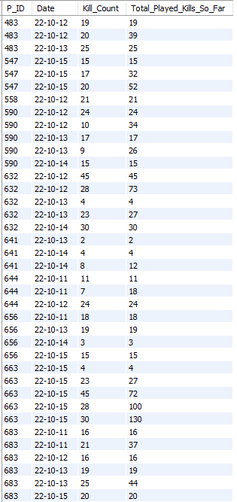
11. For each player and date, determine how many `kill_counts` were played by the player so far.

Slide 16
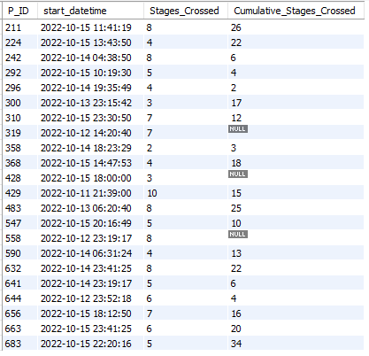
12. Find the cumulative sum of stages crossed over `start_datetime` for each `P_ID`, excluding the most recent `start_datetime`.
SELECT ld.P_ID, ld.start_datetime, ld.Stages_Crossed,
( SELECT SUM(Stages_Crossed)
FROM level_details2
WHERE P_ID = ld.P_ID
AND start_datetime < ld.start_datetime )
AS Cumulative_Stages_Crossed
FROM level_details2 ld
WHERE NOT EXISTS (
SELECT 1
FROM level_details2 ld2
WHERE ld.P_ID = ld2.P_ID
AND ld.start_datetime < ld2.start_datetime)
ORDER BY ld.P_ID, ld.start_datetime;

Slide 17

13. Extract the top 3 highest sums of scores for each `Dev_ID` and the corresponding `P_ID`
SELECT Dev_ID, P_ID, SUM(Score) AS Total_Score
FROM level_details2
GROUP BY Dev_ID, P_ID
ORDER BY Dev_ID, Total_Score DESC
LIMIT 3;

Slide 18
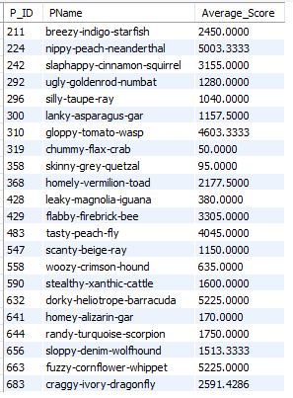
14. Find players who scored more than 50% of the average score, scored by the sum of scores for each `P_ID`.
SELECT pd.P_ID, pd.PName, AVG(ld2.Score) AS Average_Score
FROM player_details pd
JOIN level_details2 ld2
ON pd.P_ID = ld2.P_ID
JOIN ( SELECT P_ID, AVG(Score) AS Player_Avg_Score
FROM level_details2
GROUP BY P_ID) AS avg_scores
ON pd.P_ID = avg_scores.P_ID
WHERE ld2.Score > 0.5 * avg_scores.Player_Avg_Score
GROUP BY pd.P_ID, pd.PName

Slide 19
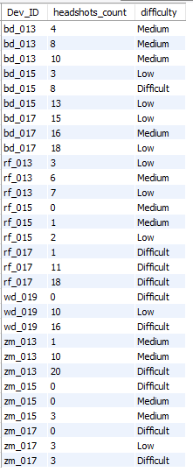
15. Create a stored procedure to find the top `n` `headshots_count` based on each `Dev_ID` and rank them in increasing order using `Row_Number`. Display the difficulty as well.
DELIMITER //
CREATE PROCEDURE FindTopHeadshotsCount(IN n INT)
BEGIN CREATE TEMPORARY TABLE temp_table AS
SELECT ld.Dev_ID, ld.headshots_count, ld.difficulty,
ROW_NUMBER()
OVER (PARTITION BY ld.Dev_ID ORDER BY ld.headshots_count) AS rn
FROM level_details2 ld
WHERE ld.headshots_count IS NOT NULL;
SELECT Dev_ID, headshots_count, difficulty
FROM temp_table
WHERE rn <= n;
DROP TEMPORARY TABLE IF EXISTS temp_table;
END //
DELIMITER ;
CALL FindTopHeadshotsCount(3);

Slide 20
THANK YOU

